Slide 1
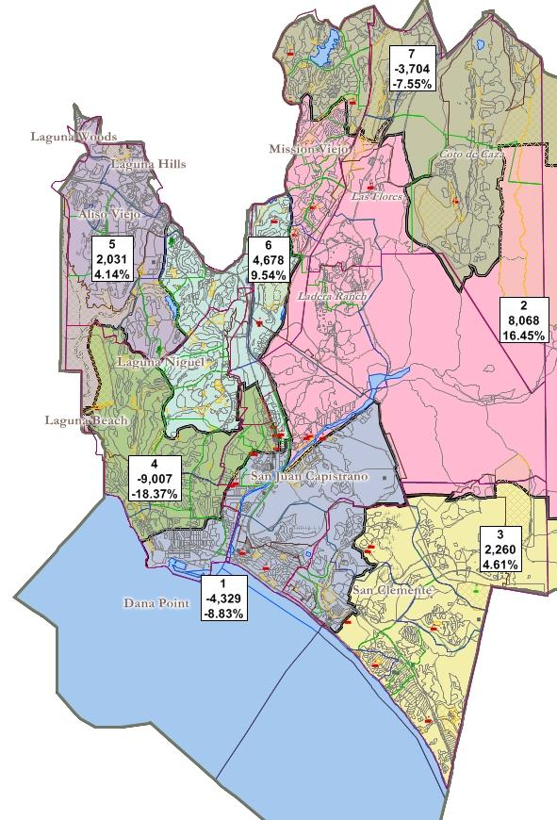
Capistrano Unified school district
2011 Redistricting
National Demographics Corporation

Slide 2
Capistrano Unified Demographics
2010 Census data:
Population
  2010 Census total: 343,291
    17.2 % Hispanic
    70.4 % Non-Hispanic white
    12.4 % Other
  2010 Census Voting Age Population
    15.1 % Hispanic
    73.1 % Non-Hispanic White
    11.8 % Other
American Community Survey data:
  Citizen Voting Age Population (CVAP)
    9.7 % Hispanic
    80.5 % Non-Hispanic White
    10.8 % Other
California Statewide Database:
  Surname Registration & Turnout
    8.3 % Hispanic of Registration
    6.8 % Hispanic of Turnout
No Majority-Hispanic CVAP Area possible.

Slide 3
Criteria
Federal Laws:
(“Must-Do”)
Equal Population
Federal Voting Rights Act
No racial gerrymandering
Traditional Redistricting Criteria
(“Balancing”)
Communities of interest
Visible (Natural & man-made) boundaries
Compactness & contiguity

Slide 4
Schedule
Nov. 19: Board Review of demographics, schedule, and criteria
Dec. 12: Presentation & Review of Draft Plans
Jan. 9: Presentation & Review of Updated Draft Plans
Jan. 25: Presentation & Review of Updated Draft Plans (possible adoption)
Feb. 13: (if needed) Adoption of Trustee Areas Plan

Slide 5
What these plans are:
Starting points on the road to a final plan
Demonstrations of the results when different criteria are emphasized
  Each plan has a significantly different focus
Plans drawn by the consultant, using the Board’s criteria, to stimulate discussion, ideas and direction

Slide 6
What these plans are not:
These are not final plans. Considerable revisions are likely prior to arriving to a final plan.
These are not exclusive. If the public or Board like parts of one plan and parts of another, in many places the different parts can be put together into a new plan.
These do not reflect any directions from any individual trustee or any groups of trustees. These were drawn by the consultant using only the criteria for guidance. These maps start the discussion, which now proceeds to public and Board input and direction.

Slide 7
Desired Feedback / Action
Public and Board comment on the plans
  Which approaches should be abandoned?
  Which make the both starting points for revisions?
  Which parts of each plan are appealing and should be incorporated into ongoing working drafts?
Direction to consultant on plan revisions/tests to prepare for review at the next meeting.

Slide 8
Draft plans a - e

Slide 9
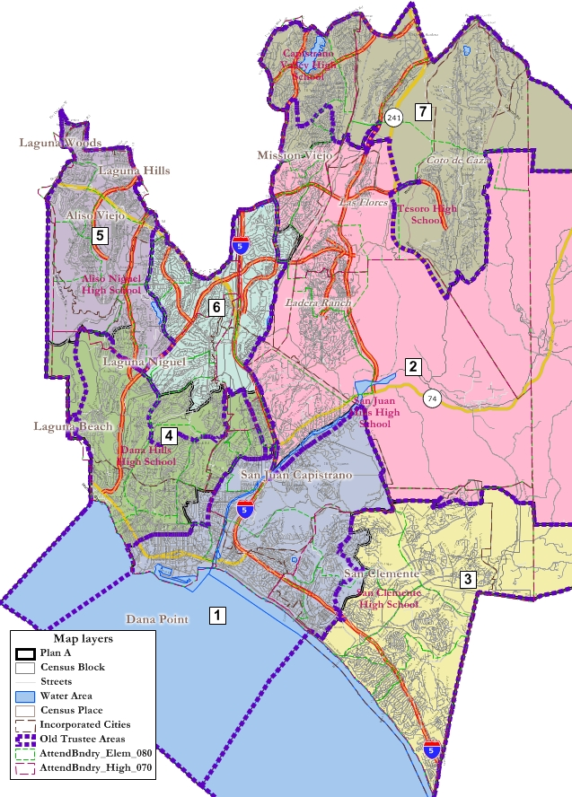
Plan A
Summary:
“Least Change” plan
  (old lines shown in purple dashes)
Relatively Compact
Not drawn looking at incumbents, but no incumbents paired
  (No surprise, given focus on smallest possible changes to existing from-trustee areas)

Slide 10
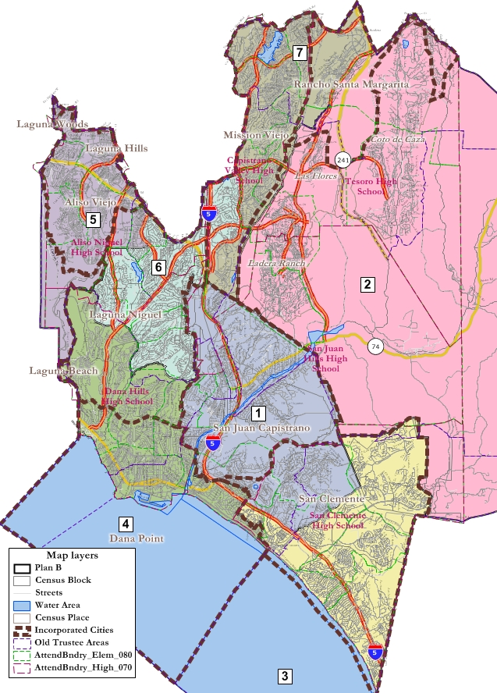
Plan B
Summary:
“City-Focused” plan
  City borders shown as brown dashes
Less compact due to non-compact city borders
Not drawn looking at incumbents
  Two trustees in Area 4
  No trustee in Area 2

Slide 11
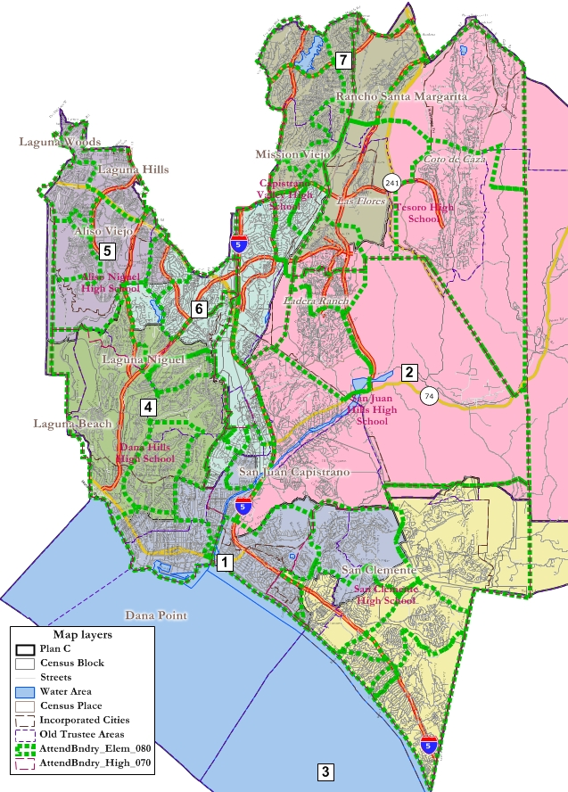
Plan C
Summary:
“Elementary Attendance Areas” plan
  Attendance areas shown as green dashes
Less compact due to non-compact attendance area borders
Not drawn looking at incumbents
  No trustees paired

Slide 12
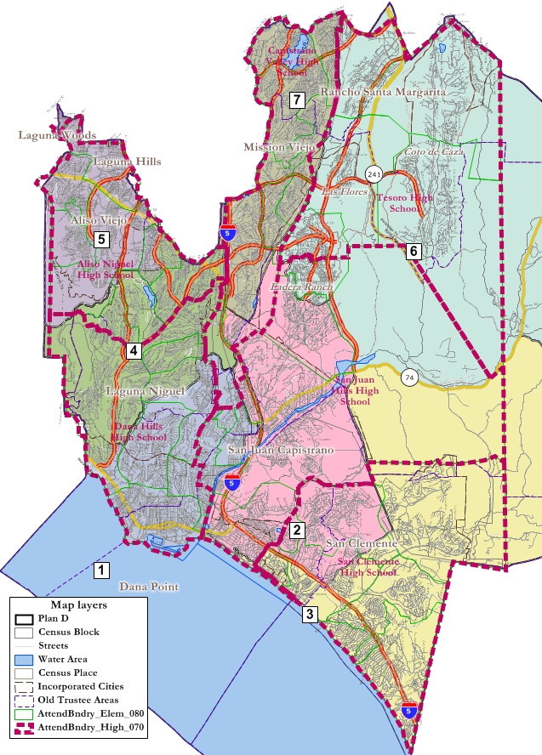
Plan D
Summary:
“High School Attendance Areas” plan
  Attendance areas shown as pink dashes
Not drawn looking at incumbents
  2 trustees in Area 7
  No trustee in Area 6

Slide 13
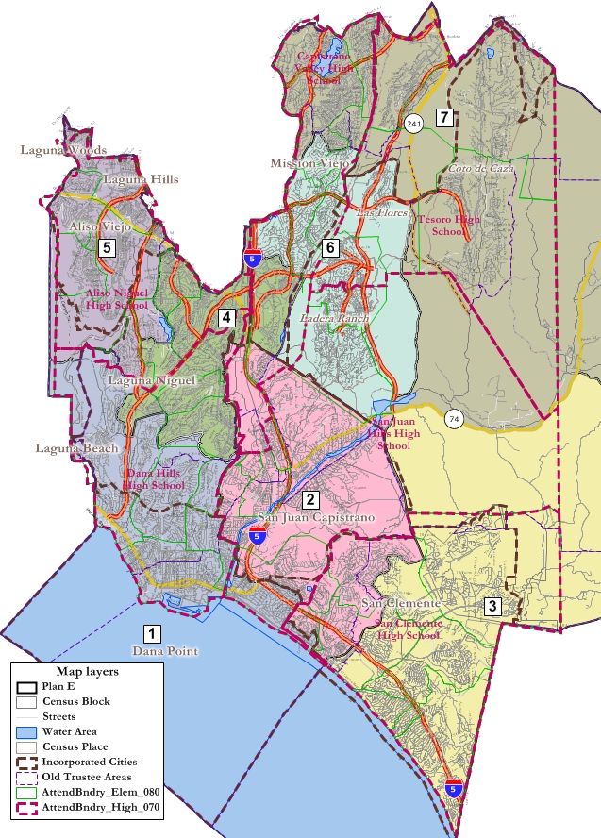
Plan E
Summary:
“Cities & High School Attendance Areas”
  Attendance areas shown as pink dashes
  Cities shown as brown lines
No incumbents paired

Slide 14
Comments, requests and/or directions?

