Slide 1
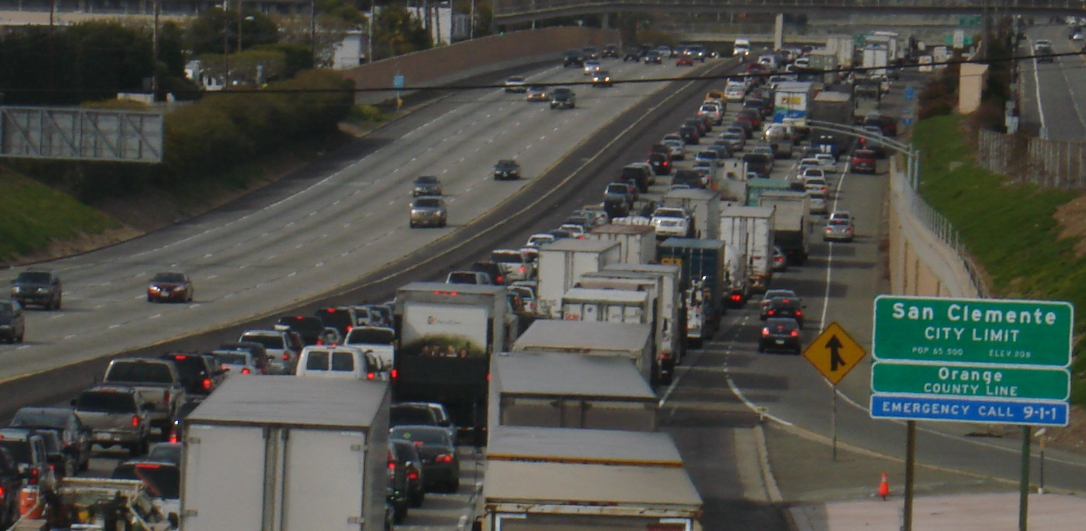
I-5 South County Improvement Projects

Slide 2
Overview of OCTA
Funds, plans and builds Orange County’s transportation system including:
Street improvements
Metrolink rail service
Countywide bus service
91 Express Lanes
Freeway improvements
Allocates federal, state and local transportation dollars including Measure M

Slide 3
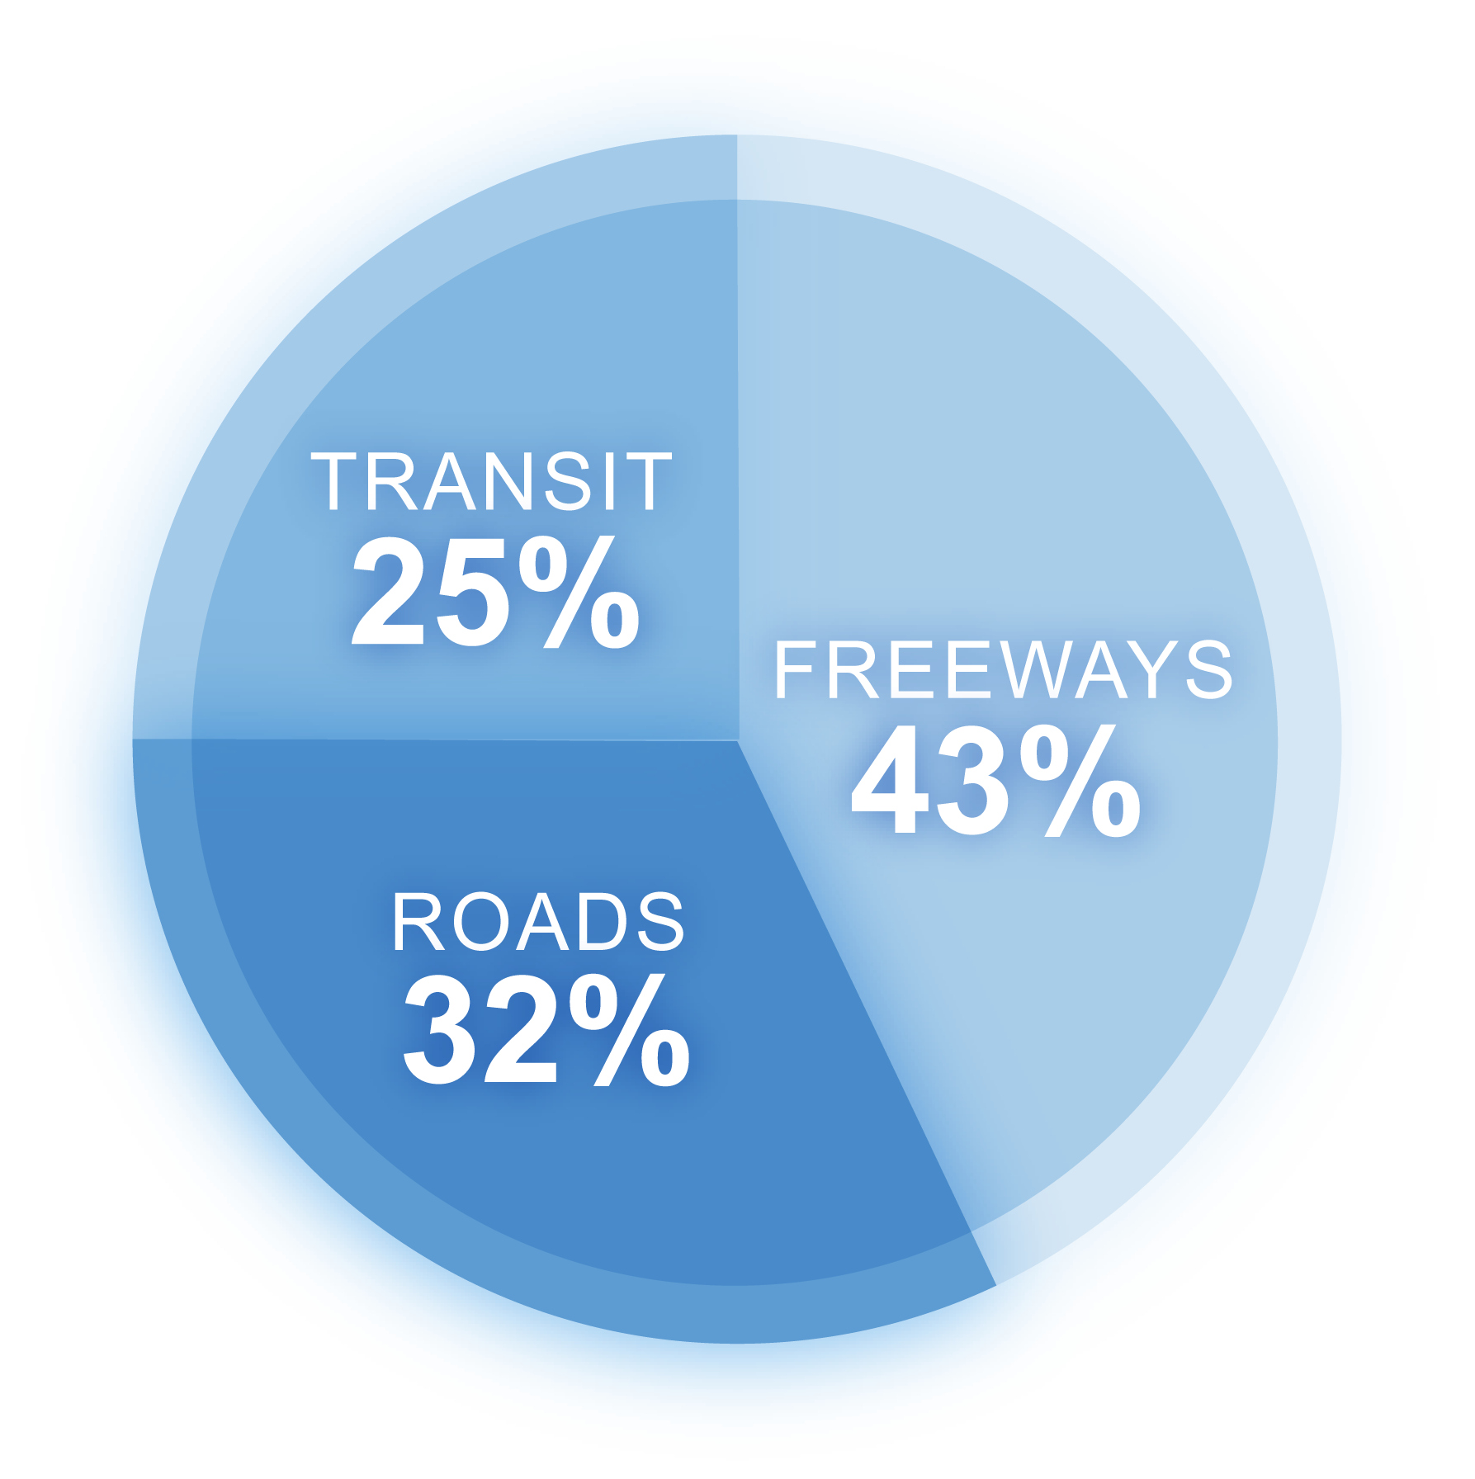
Renewed Measure M (M2)
Successful implementation of M1 completed in 2011
Renewed by voters in 2006 – began collection April 2012
30-year, $15 billion program
Innovative Environmental Programs
Taxpayer Safeguards
Roads, Transit, Freeways

Slide 4
Why Improve the I-5 in South County?
Traffic expected to increase significantly over the next 20 years
Freeway lanes congested: general purpose and carpool
Local streets and intersections also congested

Slide 5
I-5 South County Goals
Relieve local street congestion within interchange areas
Reduce congestion on I-5 within the project limits
Enhance safety
Minimize the amount of right of way acquisition needed for the project
Provide continuity of the I-5 main line carpool network within the project limits

Slide 6
Project I I-5 from Avenida Pico to San Juan Creek Road

Slide 7
Project I I-5 from Avenida Pico to San Juan Creek Road
Segments Construction Schedule
San Juan Creek Road to PCH Late 2013 to 2015
Vista Hermosa to Avenida Pico Late 2014-2017
PCH to Vista Hermosa Late 2013 to 2015

Slide 8
Project Highlights – Pico to San Juan Creek
Add one carpool lane in each direction
Improve sight distance on SB horizontal curve north of PCH
Reconstruct Avenida Pico interchange:
Widen northbound Avenida Pico on-ramp to three lanes
Provide dual left-turn lanes to both NB and SB Avenida Pico off-ramps
Add soundwalls
Approximately $275 million from Measure M, federal and state funds
Construction begins late 2013
NB= northbound
SB= southbound

Slide 9
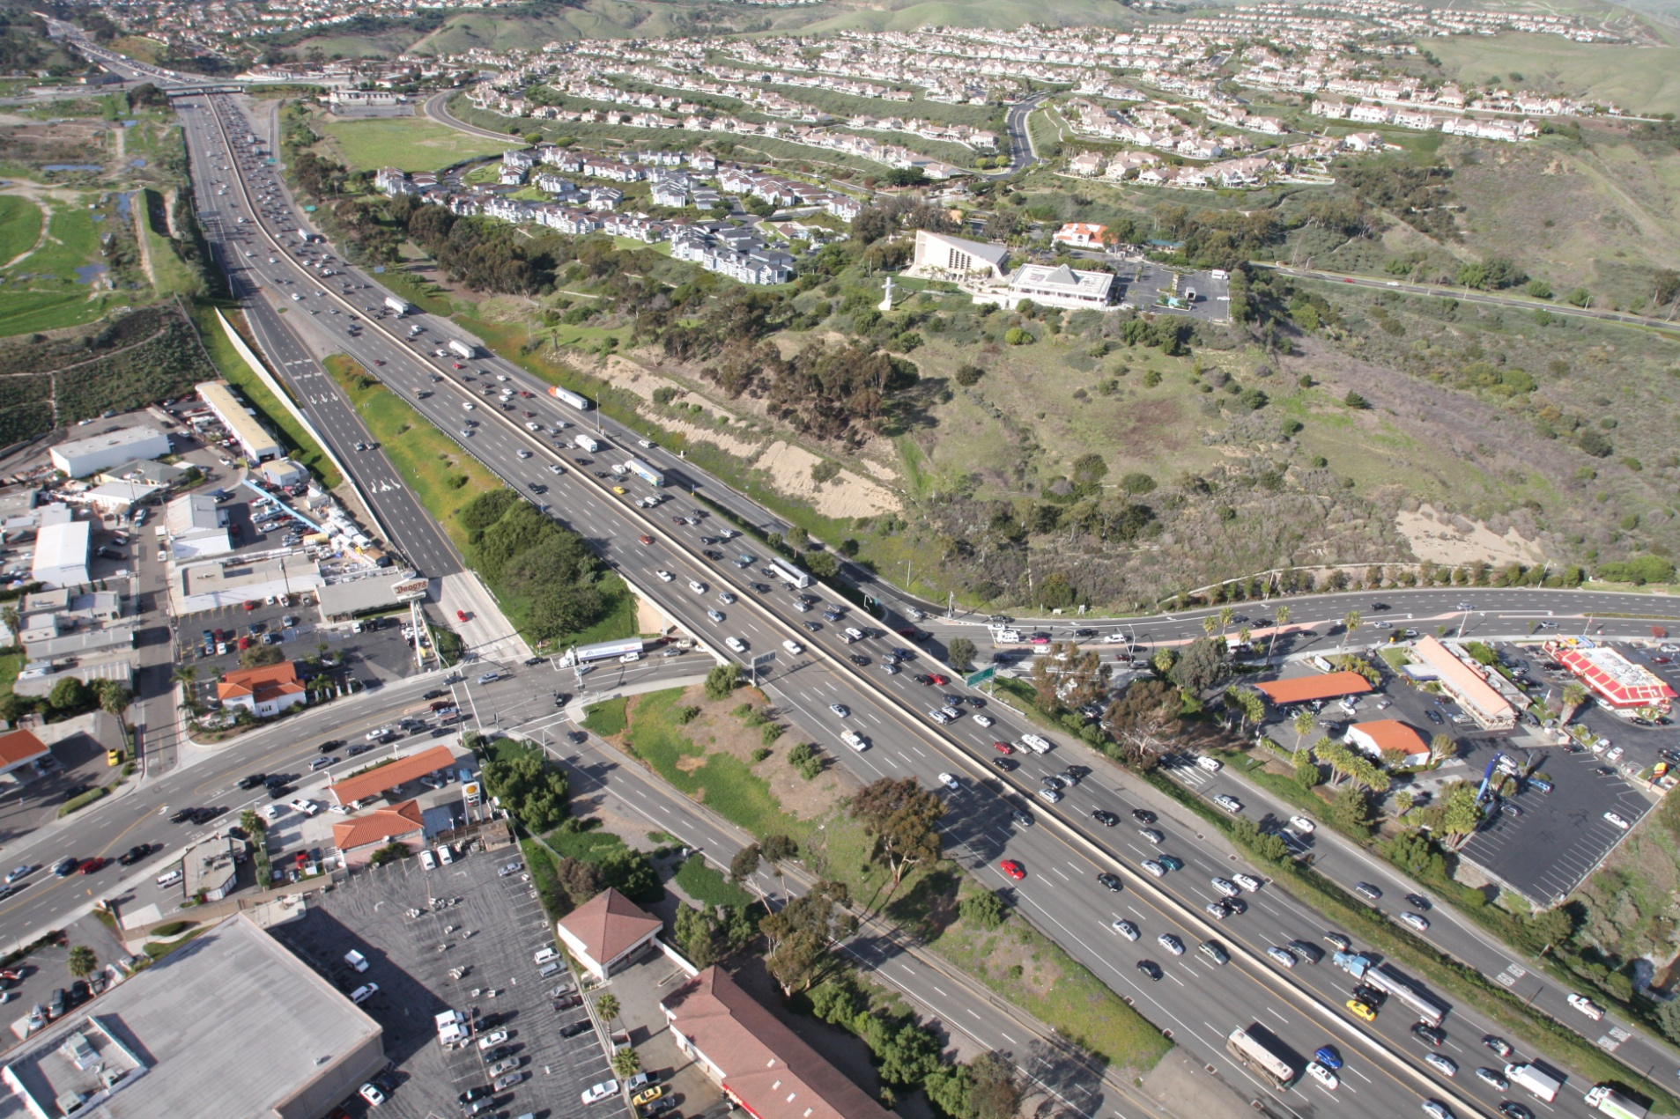
Existing Pico Interchange

Slide 10
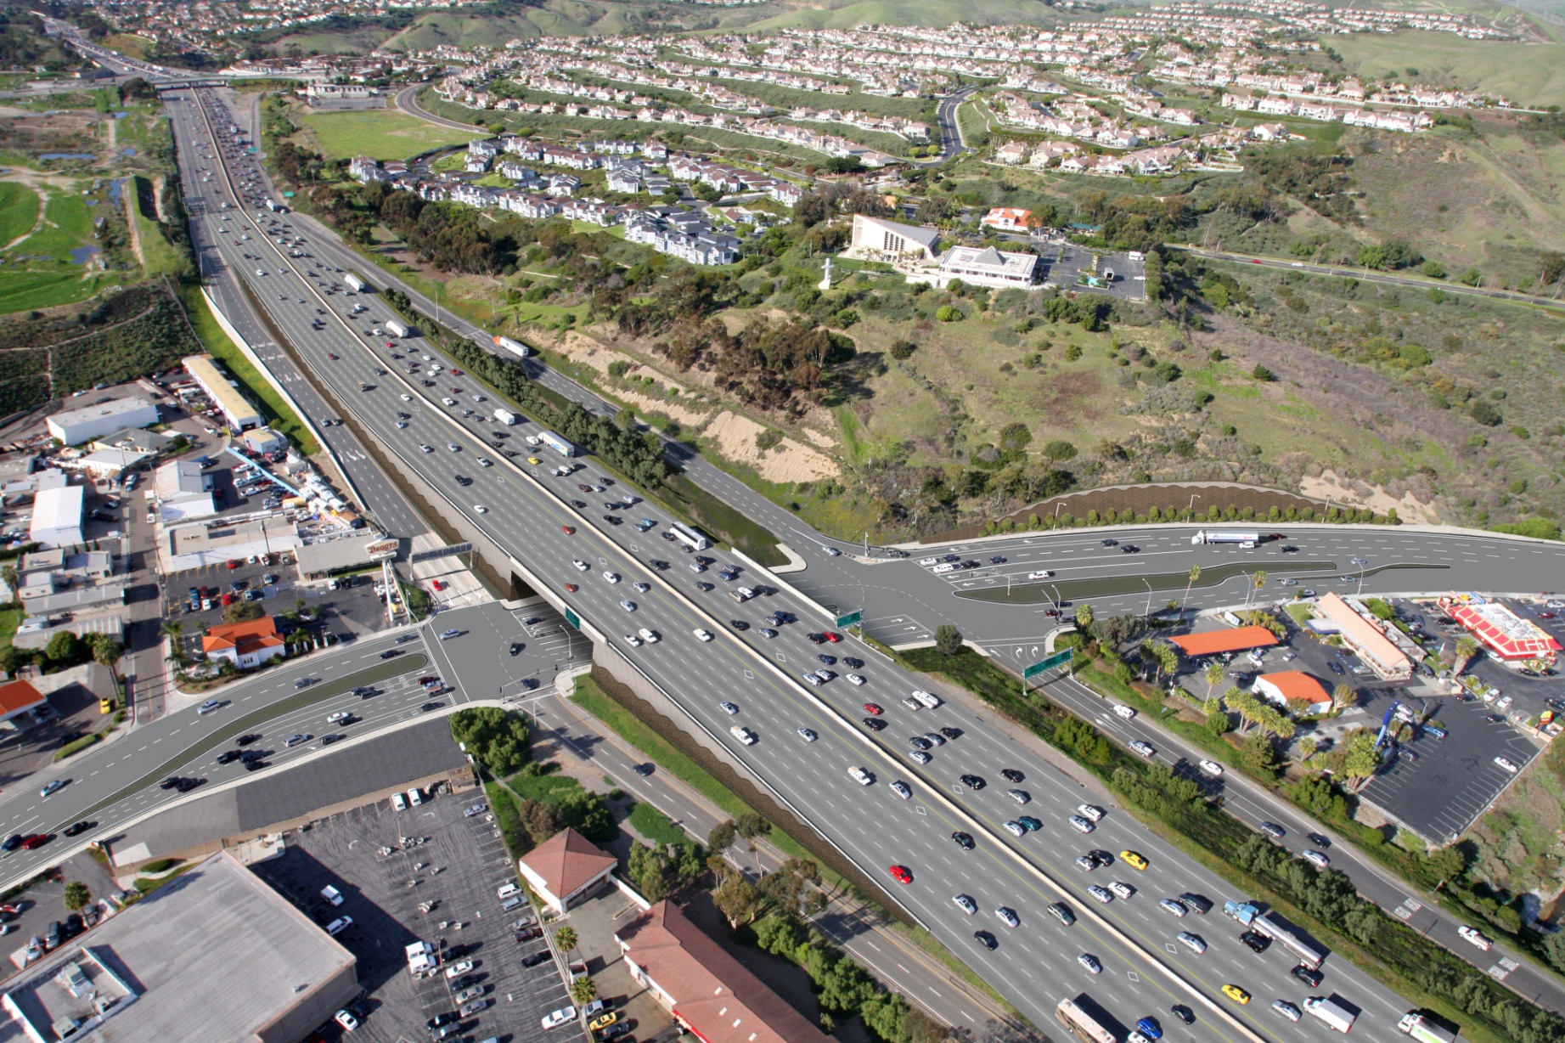
Proposed Pico Interchange

Slide 11
Anticipated Pico Interchange Schedule*
Construction Begins: Summer 2014
Remove West-Half of Bridge Fall 2014
West-Half Construction: Fall 2014-Fall 2015
Remove East-Half of Bridge: Fall 2015
East-Half Construction: Fall 2015-Winter 2016
Construction Complete: Spring 2017
*Dates subject to change due to inclement weather or other unforeseen activities
Notes:
The purpose of the PEAR is to identify early on the potential environmental issues to analyze during the environmental phase.
Some of the key issues identified for this I-405 project include air quality, community concerns, providing noise abatement, limiting right-of-way acquisitions, and addressing traffic/circulation issues in the area during the construction phase and also in the ultimate condition.
The PEAR also identifies the appropriate environmental document which in this case will be an EIR/EIS.
We will proceed with CEQA and NEPA environmental approvals since the 405 is an interstate freeway, the project approval and environmental phase is funded in part by Federal appropriations, and we will aggressively pursue Federal funds for the rest of the project.
We will work closely with Caltrans and FHWA during the environmental phase. Caltrans will be the lead agency for CEQA as well as NEPA under the NEPA Delegation Pilot Program. OCTA will be responsible for funding, procuring and administering the PA/ED professional services contract and for the CEQA/NEPA public involvement process. The cooperative agreement outlines these roles and responsibilities.

Slide 12
Pico Interchange Closures Schedule*
Crews will work to mitigate all closures. Anticipated closures are as follows:
Late Feb. 2015: SB on- and off-ramp closed for 2-4 days
Mid-Aug. 2015: SB off-ramp closed for one night
Early Nov. 2016: NB on- and off-ramp closed for 2-4 days
Mid- Nov. 2016: SB on- and off-ramp closed for 2-4 days
*Dates subject to change due to inclement weather or other unforeseen activities

Slide 13
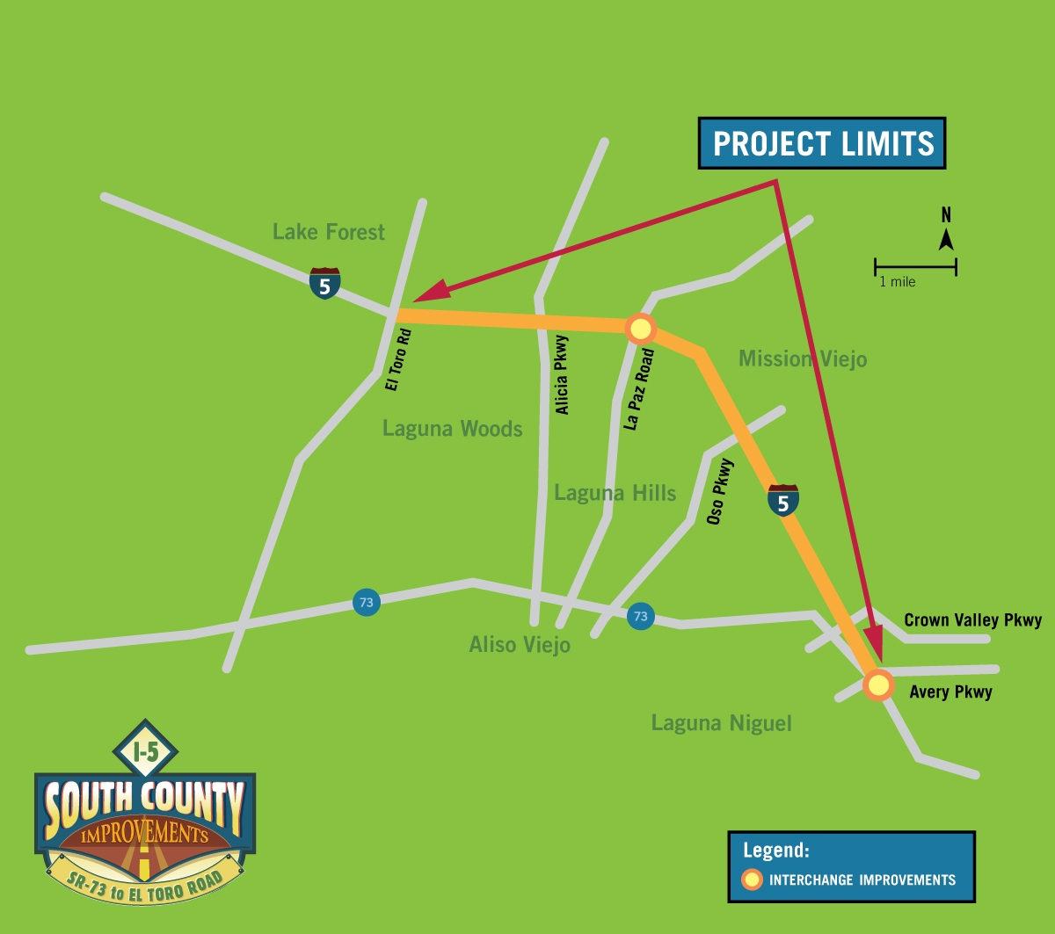
Project II: I-5 from SR-73 to El Toro Road

Slide 14
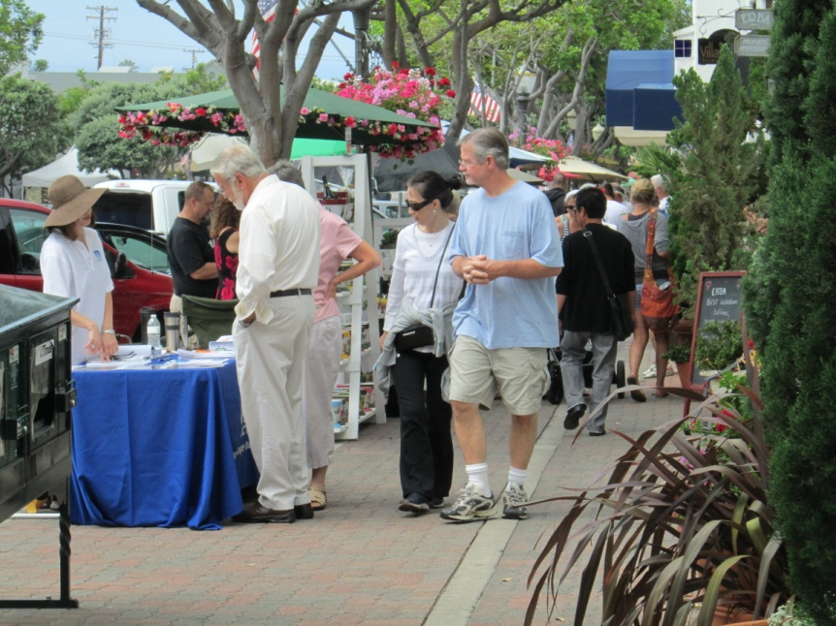
Ongoing Community Outreach
Brief officials in all impacted cities; provide council presentations in early 2013
Host community meetings
Conduct ascertainments with key stakeholders such as churches, schools, shopping centers, community groups and organizations
Host speakers bureau
Update Facebook posts
Share website updates
Distribute e-Newsletters

Slide 15
2013 Look Ahead
Pico to San Juan Creek Road
Community Presentations – ongoing
Stakeholder Working Group – quarterly (April)
Council presentations to all impacted cities – Fall
Community Open Houses – late Summer/early Fall
Groundbreaking – Fall 2013
SR-73 to El Toro Road
Council presentations to all impacted cities – Ongoing
Open Houses – February 27 & 28, 2013
Public Hearing – July 2013

Slide 16
Thank You!
For more information contact:
Julie Toledo
Community Relations Specialist
714-560-5573
jtoledo@octa.net
Check us out online at:
www.facebook.com/OCI5SouthCounty
www.octa.net/I5Pico
www.octa.net/I5ElToro

