Slide 1
Capistrano Unified School District
Board Meeting
February 13, 2013

Slide 2
Project Objectives
Provide congestion relief
Improve traffic operations
Create consistency with local development
Improve travel times
Notes:
The following will be accomplished as part of this project:
Provide congestion relief to improve
local traffic flow as well as ease regional
commutes
• Relieve the existing traffic congestion
chokepoint at the I-5 / Ortega Highway
Interchange
• Improve traffic safety and operations at
the I-5 / Ortega Highway interchange
• Eliminate existing geometric deficiencies
• Create consistency with existing and
planned local development

Slide 3
Project Funding
Source Amount
Local (City & Measure) $4,200,000
County (CFD Funds) $4,074,000
STIP-RIP $47,014,000
CMIA $30,926,000
TOTAL $86,214,000
Notes:
Funding break down:

Slide 4
Construction Schedule
Advertisement June 4, 2012
Bid Opening August 2, 2012
Construction Start February 15, 2013
Construction Completion Spring 2015
Plant Establishment Spring 2016
550 Working days
250 Plant Establishment days

Slide 5
Current Interchange

Slide 6
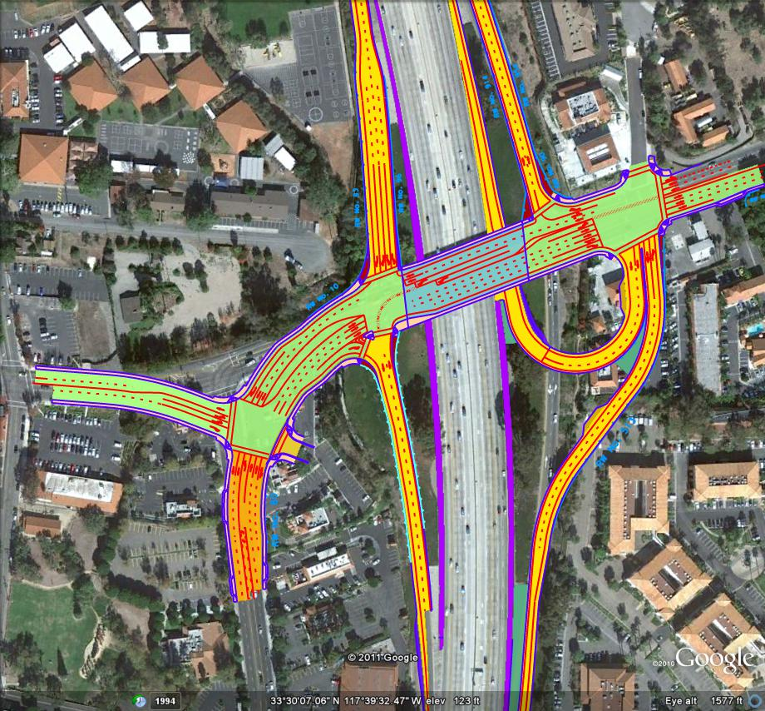
Project Scope
Reconstruct
Bridge
Widening SB off-ramp
Reconstruct SB & NB on-ramps
Construct NB loop on-ramp
Reconfigure NB off-ramp
Reconfigure Del Obispo

Slide 7
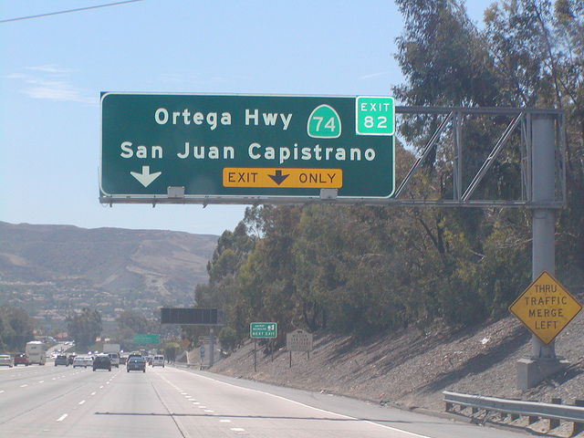
Intermittent Nighttime Closures 12:00 a.m. – 5:00 a.m. Weekdays 12:00 a.m. – 6/7:00 a.m. Weekends
SB I-5 Freeway
NB I-5 Freeway
SB I-5 Off-Ramp
NB I-5 Off-Ramp
SB I-5 On-Ramp
WB Ortega Highway
EB Ortega Highway

Slide 8
Suggested Detours
Rancho Viejo Road
Ortega Highway (SR-74)
San Juan Creek Road / Valle Road
La Novia Avenue
Camino Capistrano
Del Obispo Street
Notes:
Caltrans has worked closely with the City of San Juan Capistrano to establish detour routes on the following streets.

Slide 9
Long-Term Closures
NB I-5 Off-Ramp at Ortega Highway (3 weeks)
SB I-5 On-Ramp at Ortega Highway (6 weeks)
Ortega Highway between SB I-5 ramps and Del Obispo Street (3 weeks)
Ortega Highway between Del Obispo Street and El Camino Real (4 weeks)

Slide 10
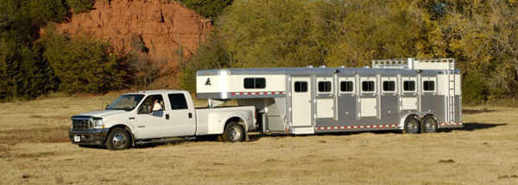
Truck Restrictions
While the Ortega Highway bridge is under construction, large trucks and trailers more than 40-feet long will be unable to exit the I-5 southbound off-ramp to eastbound Ortega Highway & will have to utilize alternate routes.
Notes:
During specific stages of the project, large trucks and trailers more than 40-feet long will not be able to maneuver through particular construction zones. While the Ortega Highway bridge is under construction, large trucks and trailers will be unable to exit the I-5 southbound off-ramp to eastbound Ortega Highway and will have to utilize alternate routes.
Caltrans will be communicating these impacts to the trucking industry as well as local businesses ahead of the closures. For a list of detailed truck detours, please visit ortega.dot.ca.gov.

Slide 11
Stage 1A

Slide 12
Ortega Highway Bridge during Construction
Notes:
The bridge traffic will be reduced to four lanes total, two lanes in each the east and west-bound direction.

Slide 13
Stage 1B

Slide 14
Northbound I-5 Off-Ramp
Notes:
From the northbound I-5, exit Camino Capistrano, turn left on to Valle Road. Turn left on to San Juan Creek Road, right on to Camino Capistrano. Turn right on to Del Obispo Street and continue to Ortega Highway.
From the northbound I-5, exit Junipero Serra Road, turn right on to Junipero Serra Road. Turn right on to Rancho Viejo Road and continue to Ortega Highway.

Slide 15
Stage 1E

Slide 16
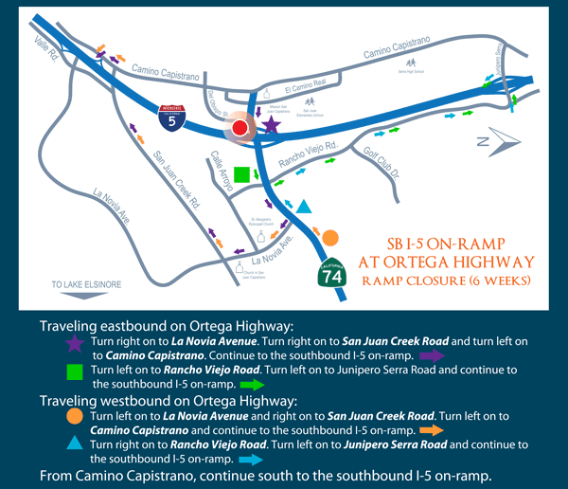
Southbound I-5 On-Ramp
Notes:
Traveling eastbound on Ortega Highway:
Turn right on to La Novia Avenue. Turn right on to San Juan Creek Road and turn left on to Camino Capistrano. Continue to the southbound I-5 on-ramp.
Turn left on to Rancho Viejo Road. Turn left on to Junipero Serra Road and continue to the southbound I-5 on-ramp.
Traveling westbound on Ortega Highway:
Turn left on to La Novia Avenue and right on to San Juan Creek Road. Turn left on to Camino Capistrano and continue to the southbound I-5 on-ramp.
Turn right on to Rancho Viejo Road. Turn left on to Junipero Serra Road and continue to the southbound I-5 on-ramp.
From Camino Capistrano, continue south to the southbound I-5 on-ramp.

Slide 17
Stage 1F

Slide 18
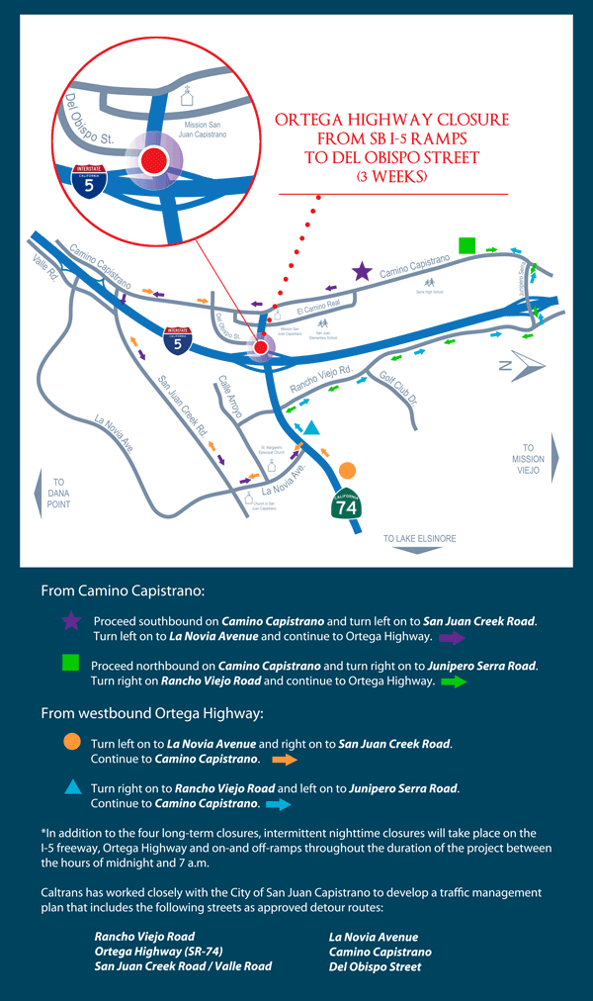
Ortega Highway SB I-5 Ramps to Del Obispo St.
Notes:
Same Detours as Ortega from El Camino Real to Del Obispo
From Camino Capistrano:
Proceed southbound on Camino Capistrano and turn left on to San Juan Creek Road. Turn left on to La Novia Avenue and continue to Ortega Highway.
Proceed northbound on Camino Capistrano and turn right on to Junipero Serra Road. Turn right on Rancho Viejo Road and continue to Ortega Highway.
From westbound Ortega Highway:
Turn left on to La Novia Avenue and right on to San Juan Creek Road. Continue to Camino Capistrano.
Turn right on to Ranch Viejo Road and left on to Junipero Serra Road. Continue to Camino Capistrano.

Slide 19
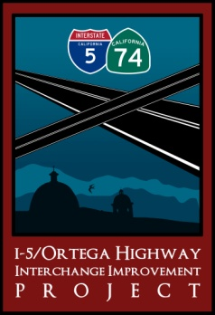
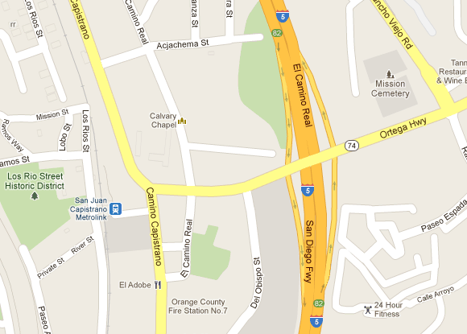
Reconstruction & Realignment and Utility Relocation
Full Closure between I-5 on and off-ramp & Del Obispo :
3 Weeks
Full Closure Between Del Obispo & El Camino Real: 4 Weeks

Slide 20
Stage 2B

Slide 21
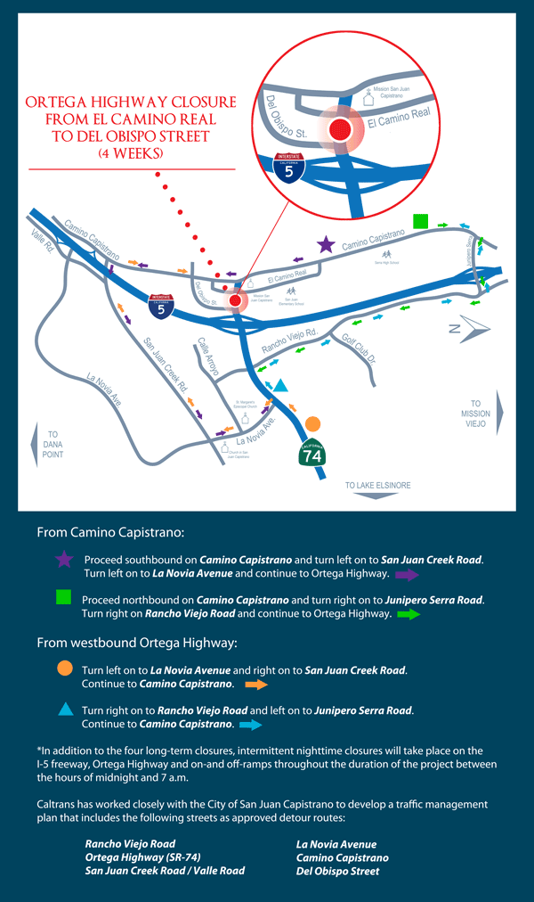
Ortega Highway El Camino Real to Del Obispo St.
Notes:
From Camino Capistrano:
Proceed southbound on Camino Capistrano and turn left on to San Juan Creek Road. Turn left on to La Novia Avenue and continue to Ortega Highway.
Proceed northbound on Camino Capistrano and turn right on to Junipero Serra Road. Turn right on Rancho Viejo Road and continue to Ortega Highway.
From westbound Ortega Highway:
Turn left on to La Novia Avenue and right on to San Juan Creek Road. Continue to Camino Capistrano.
Turn right on to Ranch Viejo Road and left on to Junipero Serra Road. Continue to Camino Capistrano.

Slide 22
Construction Completion

Slide 23
Ortega Highway Interchange Final Configuration

Slide 24
Improved Interchange
Notes:
The improved interchange is pictured
This project will
Reconstruct SR-74 bridge over I-5,
reconfigure Del Obispo and the NB off ramp from the I-5,
create a NB loop for I-5 from SR-74,
reconstruct SB & NB on ramps on I-5,
Widen SB I-5 off ramp

Slide 25
Rendering of Ortega Highway Bridge

Slide 26
Rendering of Southbound Off-ramp

Slide 27
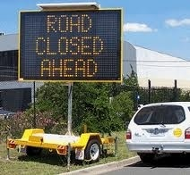
Traffic Management
Public Outreach
Motorist Information
Construction Strategies
Contingency Plans
Incident Management, Construction Zoned Enhanced Enforcement Program, Transportation Management Center
Notes:
Public Outreach – Various Media
Motorist Information – Portable Changeable Message Signs (PCMS), Construction Area Signs
Incident Management, Construction Zoned Enhanced Enforcement program, Transportation Management Center (TMC Support)
Construction strategies: Lane Closure Chart and Traffic Handling Plans
Contingency Plans: Construction Operations and Traffic Handling

Slide 28
Public Outreach
Dedicated community liaison
Proactive communication
100% response rate
Outreach to key stakeholders
Social media
Traditional media
Community events
Flyers / Canvassing
Weekly construction alerts
PSA
Bill Inserts
Notes:
Caltrans and CALTROP have developed a robust public outreach campaign to ensure the community is well informed of all activities on the project….

Slide 29
Thank You!

