Slide 1
Parenting in Todays Society
Outreach & Engagement

Slide 2
Outreach & Engagement
Free Services for All Ages
Case Management.
Workshops.
Support Groups.
Referral & Linkage.
Services are available for all who live in Orange County
WYS CLINIC
Therapy
-Up to the age of 21
-Medical

Slide 3
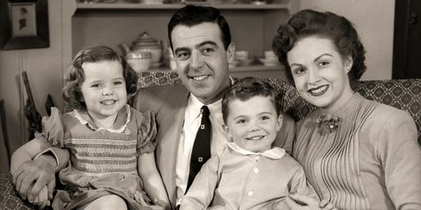
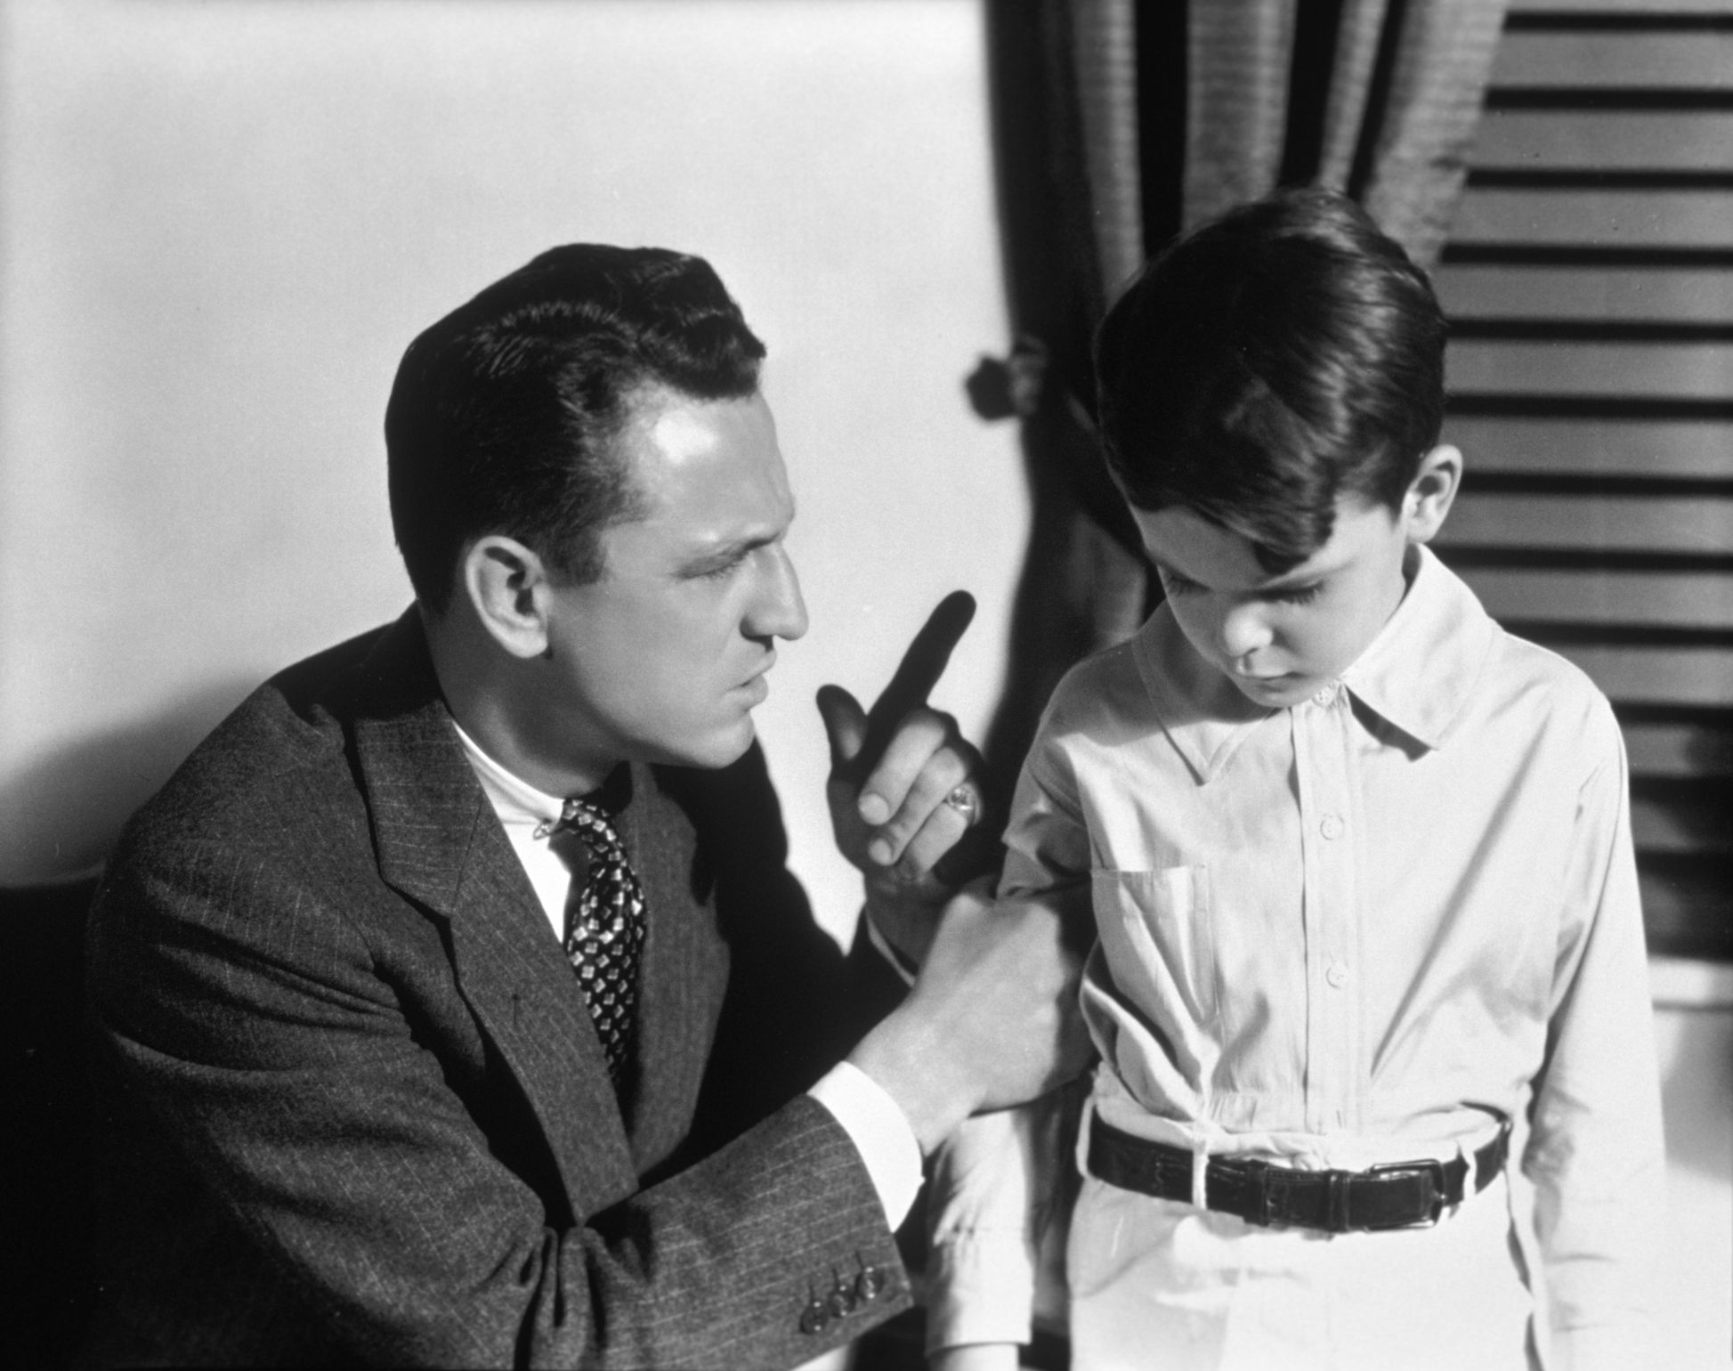
Parenting
Why does it seem so hard to parent today?
Was it always this difficult?

Slide 4
In defense of Old School Parenting
“Look at me I turned out alright”
What good things do you remember and what do you not wish upon your own kids?

Slide 5
What were some positives
of old-school parenting?
Firm discipline
Respect
Hard work

Slide 6
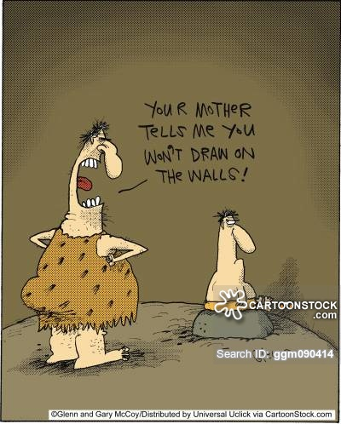
What were some negatives
of old school parenting?
Lack of emotional support - “Because I said so”
Physical abuse (Belt, Shoe, Switch, Paddle)
Corporal punishment (Spanking and yelling)
Modeling – “Do as I say not as I do”

Slide 7
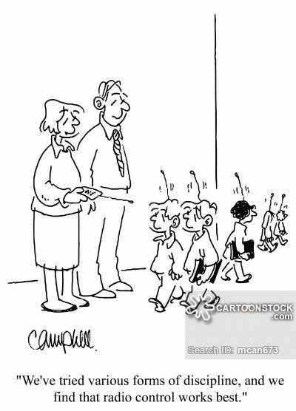
Discussion
What are some positives on how you were raised?
What are some negatives on how you were raised?
Notes:
Have parents share with a person next to them.

Slide 8
Why is parenting different today?
Our life is a public platform by choice
Explosion of Information – (Internet, Cable TV, Social Media)
Social Narcissism ( Everything is perfect – look at me and my food)
Social Shaming (You aren’t doing it right, parent bullying)
Higher expectations (Everyone has to be the valedictorian, pianist, violin playing, AP classes)
Notes:
This is true for kids and adults alike.

Slide 9
How do we parent in today society
Externals (Structure, stability, boundaries)
Internals (Emotional and Relational)

Slide 10
Externals
Structure (Rules, guidelines, expectations, rewards, consequences)
Stability (Home life, routines, support systems)
Boundaries (Safety, friends, consequences)
Notes:
Developing structure and stability helps a child feel safe externally.
Video games, phones, internet,

Slide 11
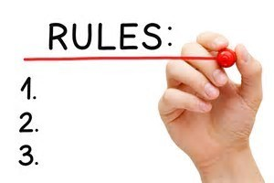
Externals
What are some ground rules in your home and why are they important to you?
Does your ground rule have any room for discussion?
Notes:
Developing structure and stability helps a child feel safe externally. All parents have strong ground rules. Why are they important to them.

Slide 12
Internals (Emotional & Relational)
Talk with your kids
Be a listener not a nagger
Affirm them in the smallest things
Guide them to make good decisions
Love them unconditionally
Notes:
Talk with your kids
Be a listener not a nagger
Affirm them in the smallest things
Challenge them to make good decisions

Slide 13
Problem Solving Flowchart
1. Ask Open Ended Questions
2. Listen don’t judge “Tell me more”
3. Coach to provide solutions
4. Guide & Affirm
5. Allow ability for child to follow up with you

Slide 14
Problem Solving Flowchart
Scenario:
Your child gets into the car after school and shares with you that Johnny got busted with a Vape (charger) in his backpack.
Using the problem solving flow chart pair up with someone and role play this situation.
1. Ask Open Ended Questions
2. Listen don’t judge
“Tell me more”
3. Coach to provide solutions
4. Guide & Affirm
5. Allow ability for child to follow up with you

Slide 15
Discussion
What challenged you?
What is something you feel affirmed of?
What is something new you want to try with your kids?

Slide 16
Conclusion
“There is no such thing as a perfect parent so just be a real one.”

