Slide 1
How to Support A Growth Mindset
Parent Workshop
Capistrano Unified School District

Slide 2
Introduction
Rebecca Pianta, Coordinator, Counseling & Student Support
Alexandra Todd, School Counselor at Esencia & Oso Grande Elementary School

Slide 3
Objectives: Participants will...
Assess their own mindset
Understand what is a fixed mindset
Understand what is a growth mindset
Understand brain development
Understand how mindset affects learning and behavior
Gain strategies for reinforcing a growth mindset in their children and themselves

Slide 4
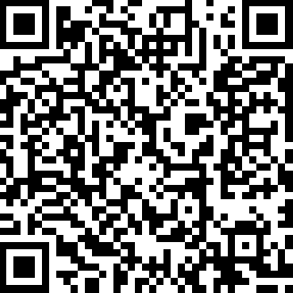
Activity: Assess your Mindset
http://blog.mindsetworks.com/what-is-my-mindset

Slide 5
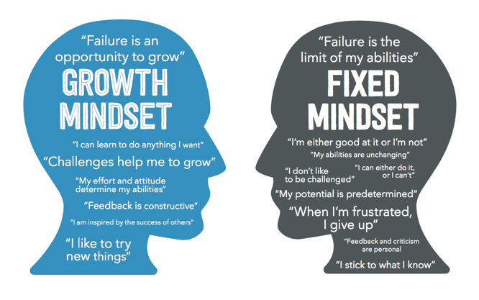
Fixed vs. Growth Mindset

Slide 6
What is a Fixed Mindset?
The idea that intelligence is fixed, or predetermined, at birth
Some people are born with the ability to succeed at certain tasks
The brain is rigid in its thinking
The brain does not change or grow over time
Stuck on an Escalator

Slide 7
What is a Growth Mindset?
Intelligence can grow and change with effort and hard work
People can learn new tasks and skills with practice
The brain is flexible, malleable & adaptable in its thinking
The brain CAN change or grow over time
The brain has the quality of neuroplasticity

Slide 8
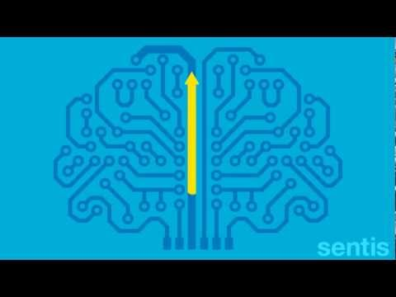
Neuroplasticity

Slide 9
How does Mindset affect Learning and Behavior?

Slide 10
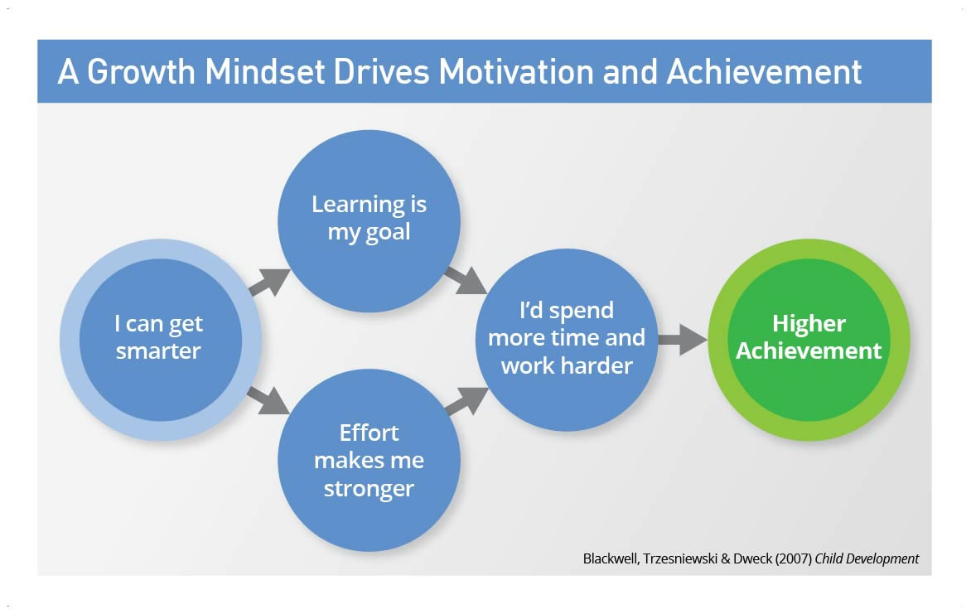
Mindset can Drive Thoughts, Feelings, and Behaviors

Slide 11
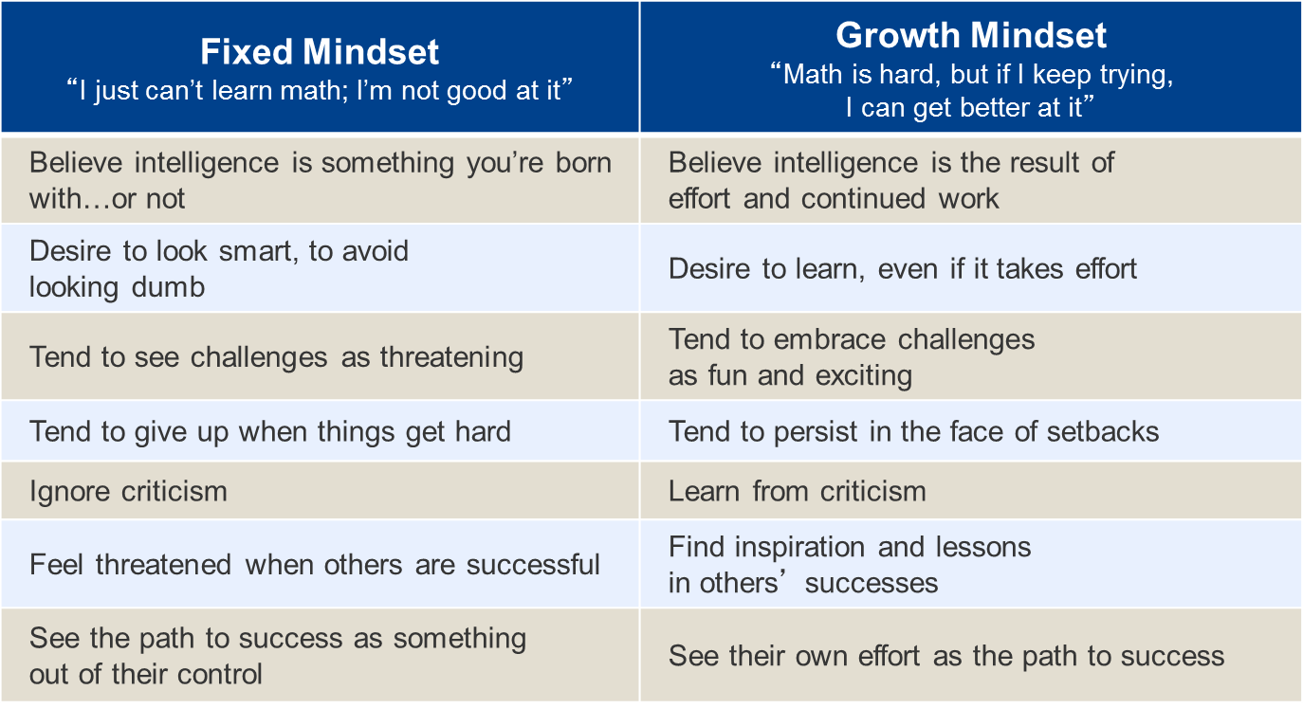

Slide 12
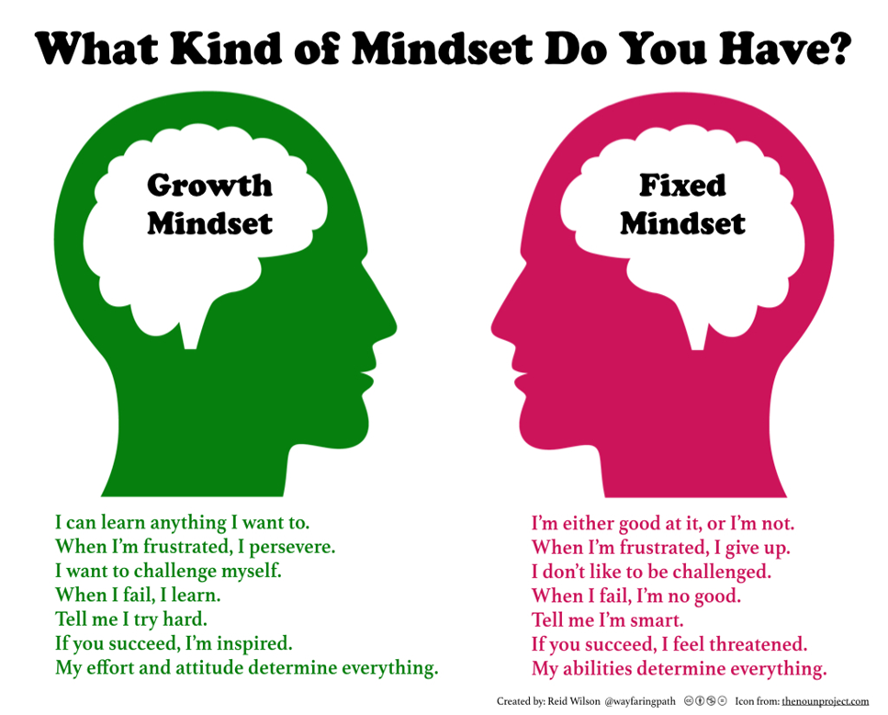

Slide 13
How can having a Growth Mindset help your Children?
Students with a growth mindset have a more positive outlook toward school
Students with a growth mindset earn better grades that students with a fixed mindset
Students with a growth mindset spend less time struggling with homework
… have an overall higher level of achievement and a greater sense of free will!
(Dr. Carol Dweck, 2006)

Slide 14
Strategies for Supporting Growth Mindset

Slide 15
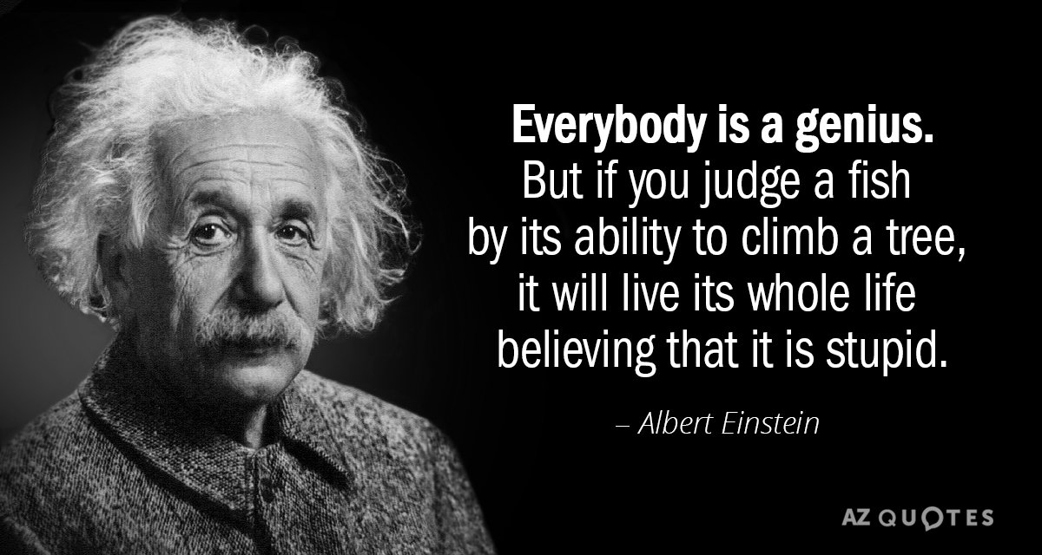
Have Realistic Expectations

Slide 16
Teach Children about Neuroplasticity

Slide 17

Teach Children about the Power of Yet

Slide 18
Use If-Then Thinking
“If you want to play the piano, then you must practice three times a week.”
“If you want to get full marks on your spelling test, then you must study for the test.”

Slide 19
Positively Model Making Mistakes
Reflect with your child about mistakes that you have made and lessons learned from them.
When you make mistakes in front of your child, be positive. Openly own up to your mistakes, try to rectify them, and reflect on the lessons learned.
When your child makes a mistake, remain calm and help your child think through what could be learned from it.

Slide 20
How to Change your Mindset
Catch yourself using a FIXED mindset
Change your language
Embrace the challenge
See failure as an opportunity to grow

Slide 21
How to get there: Example
Catch yourself using a FIXED mindset
  I’m not good at book reports. Why should I even try?
Change your language
  Okay, book reports have been hard for me in the past. I will apply what I have learned from my mistakes, like beginning earlier.
Embrace the challenge
  Wow, this reading is hard. My brain must be growing!
See failure as an opportunity to grow
  I still didn’t do as well as I could have...next time I will try a different strategy.

Slide 22
Changing the Language: Examples
What did you learn from today’s performance?
What steps did you take to make you successful today?
What are some different strategies you could have used?
I really appreciate the effort you used!
It’s okay to take risks, that how we learn.
You don’t have it yet, but keep thinking and working at it and I know you’ll get there.

Slide 23


Change the Way You Praise
A Study on Praise and Effort
“You worked hard on that problem!
“Wow, what strategies did you use to complete that essay?

Slide 24

Growth Mindset Revisited: Equate growth mindset with sheer effort
Only praising effort is just one route to learning
Nagging children to try hard
Praising ineffective effort

Slide 25
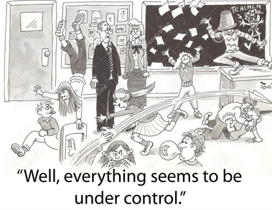
Growth Mindset Revisited: Ignoring Culture & Context
Labeling the child
Making the child responsible for their mindset
Not remembering that classroom and school triggers are critically important

Slide 26

Growth Mindset Revisited: Declaring you “have it” instead of taking the journey
Open-minded or flexible
Not simply thinking kids can learn
It’s hard work to attain and stay in growth-mindset

Slide 27
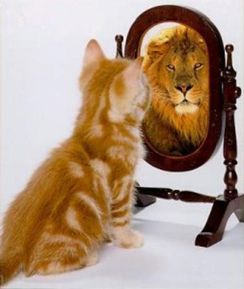
Name and claim your fixed mindset
•Watch for your fixed mindset triggers
•Name and claim your fixed mindset
•Your persona is trying to protect you
•Get your persona to join you in the growth mindset
•Set small goals. What will you do next time?
•Children can have fixed mindset personas too

Slide 28
Transmitting a Growth Mindset Children
•Growth mindset is not automatically transmitted to children
•Focus on the process & connect it to the outcome
•Collaborate on the learning process
•Link to larger goals
•Treat failures as beneficial to learning

Slide 29
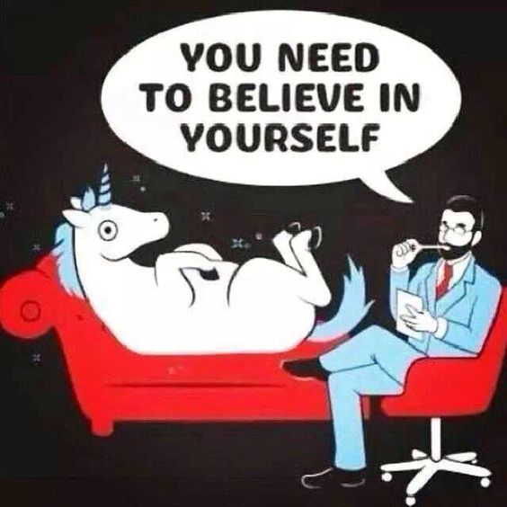
Who can you reach out to for help?
School Counselors
Teachers
Academic Advisors
School Psychologists
Administrators
Outside Counselors

Slide 30
Reflection
Which of these strategies would you be most likely to use with your children?
Notes:
R

Slide 31

Questions?
Notes:
R

