Slide 1
Parenting: Rewards & Consequences
Presented by WYS Outreach & Engagement

Slide 2
What are the challenges?
Patience
Trust
Empathy
Notes:
What are some challenges to parenting? Invite group to share then show transition of slide. Patience with child, Trust your child is telling you the truth or trusting their peers, and Empathy especially when they roll their eyes at you or call you names.

Slide 3
Overview
Rewards
Focusing on rewards first for a reason!
How to use rewards effectively
Consequences
How to use consequences effectively
Useful suggestions
Notes:
We’ll be talking about Rewards and Consequences and other useful suggestions.

Slide 4
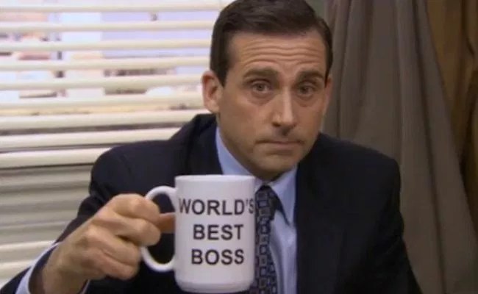
Rewards
Notes:
Have you ever had a boss that was constantly nagging you for deadlines and giving you more work to do? How did you feel?
Have you ever had a boss that praised you, listened to you, and supported you? How did you feel?
Which one do you want to be?

Slide 5
Rewards
Rewards will have a greater effect than consequences.
This applies to children, teenagers, and even adults.
Rewards should typically be given when the “good behavior” is shown.

Slide 6
How to Use Rewards
What are some motivators?
What is it that would motivate your child?
What interest do they have?
Notes:
What are some motivators? Screen time, Wifi Time, extra data plan, extra half hour for curfew, phone upgrade, vbucks, prepaid visa card for vbucks.

Slide 7
How to Use Rewards
Set realistic goals.
If the child feels they can’t achieve the goal, they won’t try.
The child should be able to earn their reward about 75% of the time.

Slide 8
How to Use Rewards
Should be given regularly and consistently.
Offer small rewards rather than one big one.
Ex: Instead of one big reward at the end for getting straight A’s, try giving smaller rewards for the child completing their homework.
Always follow through.
If you promised a reward, there should be a reward.
Not keeping your word will lower trust.
Notes:
If you can’t keep your promise then don’t offer that reward. Ie. I will get you a phone upgrade or a new phone if you…

Slide 9
How to Use Rewards
Set clear, specific requirements to receive a reward.
Your idea of a clean room may be different than your child’s idea.
Ex: “If you pick your clothes up off the floor and put them in the dresser, vacuum, and make your bed, we can go to the toy store.”
Be clear about the reward itself and set appropriate limits.
Ex: “You can pick any toy that is $10 or less.”
Notes:
Be specific on your requirements but don’t add to it once you set the standard.
Set limits such as one extra hour on the ipad or 30 minutes extra on curfew time.

Slide 10
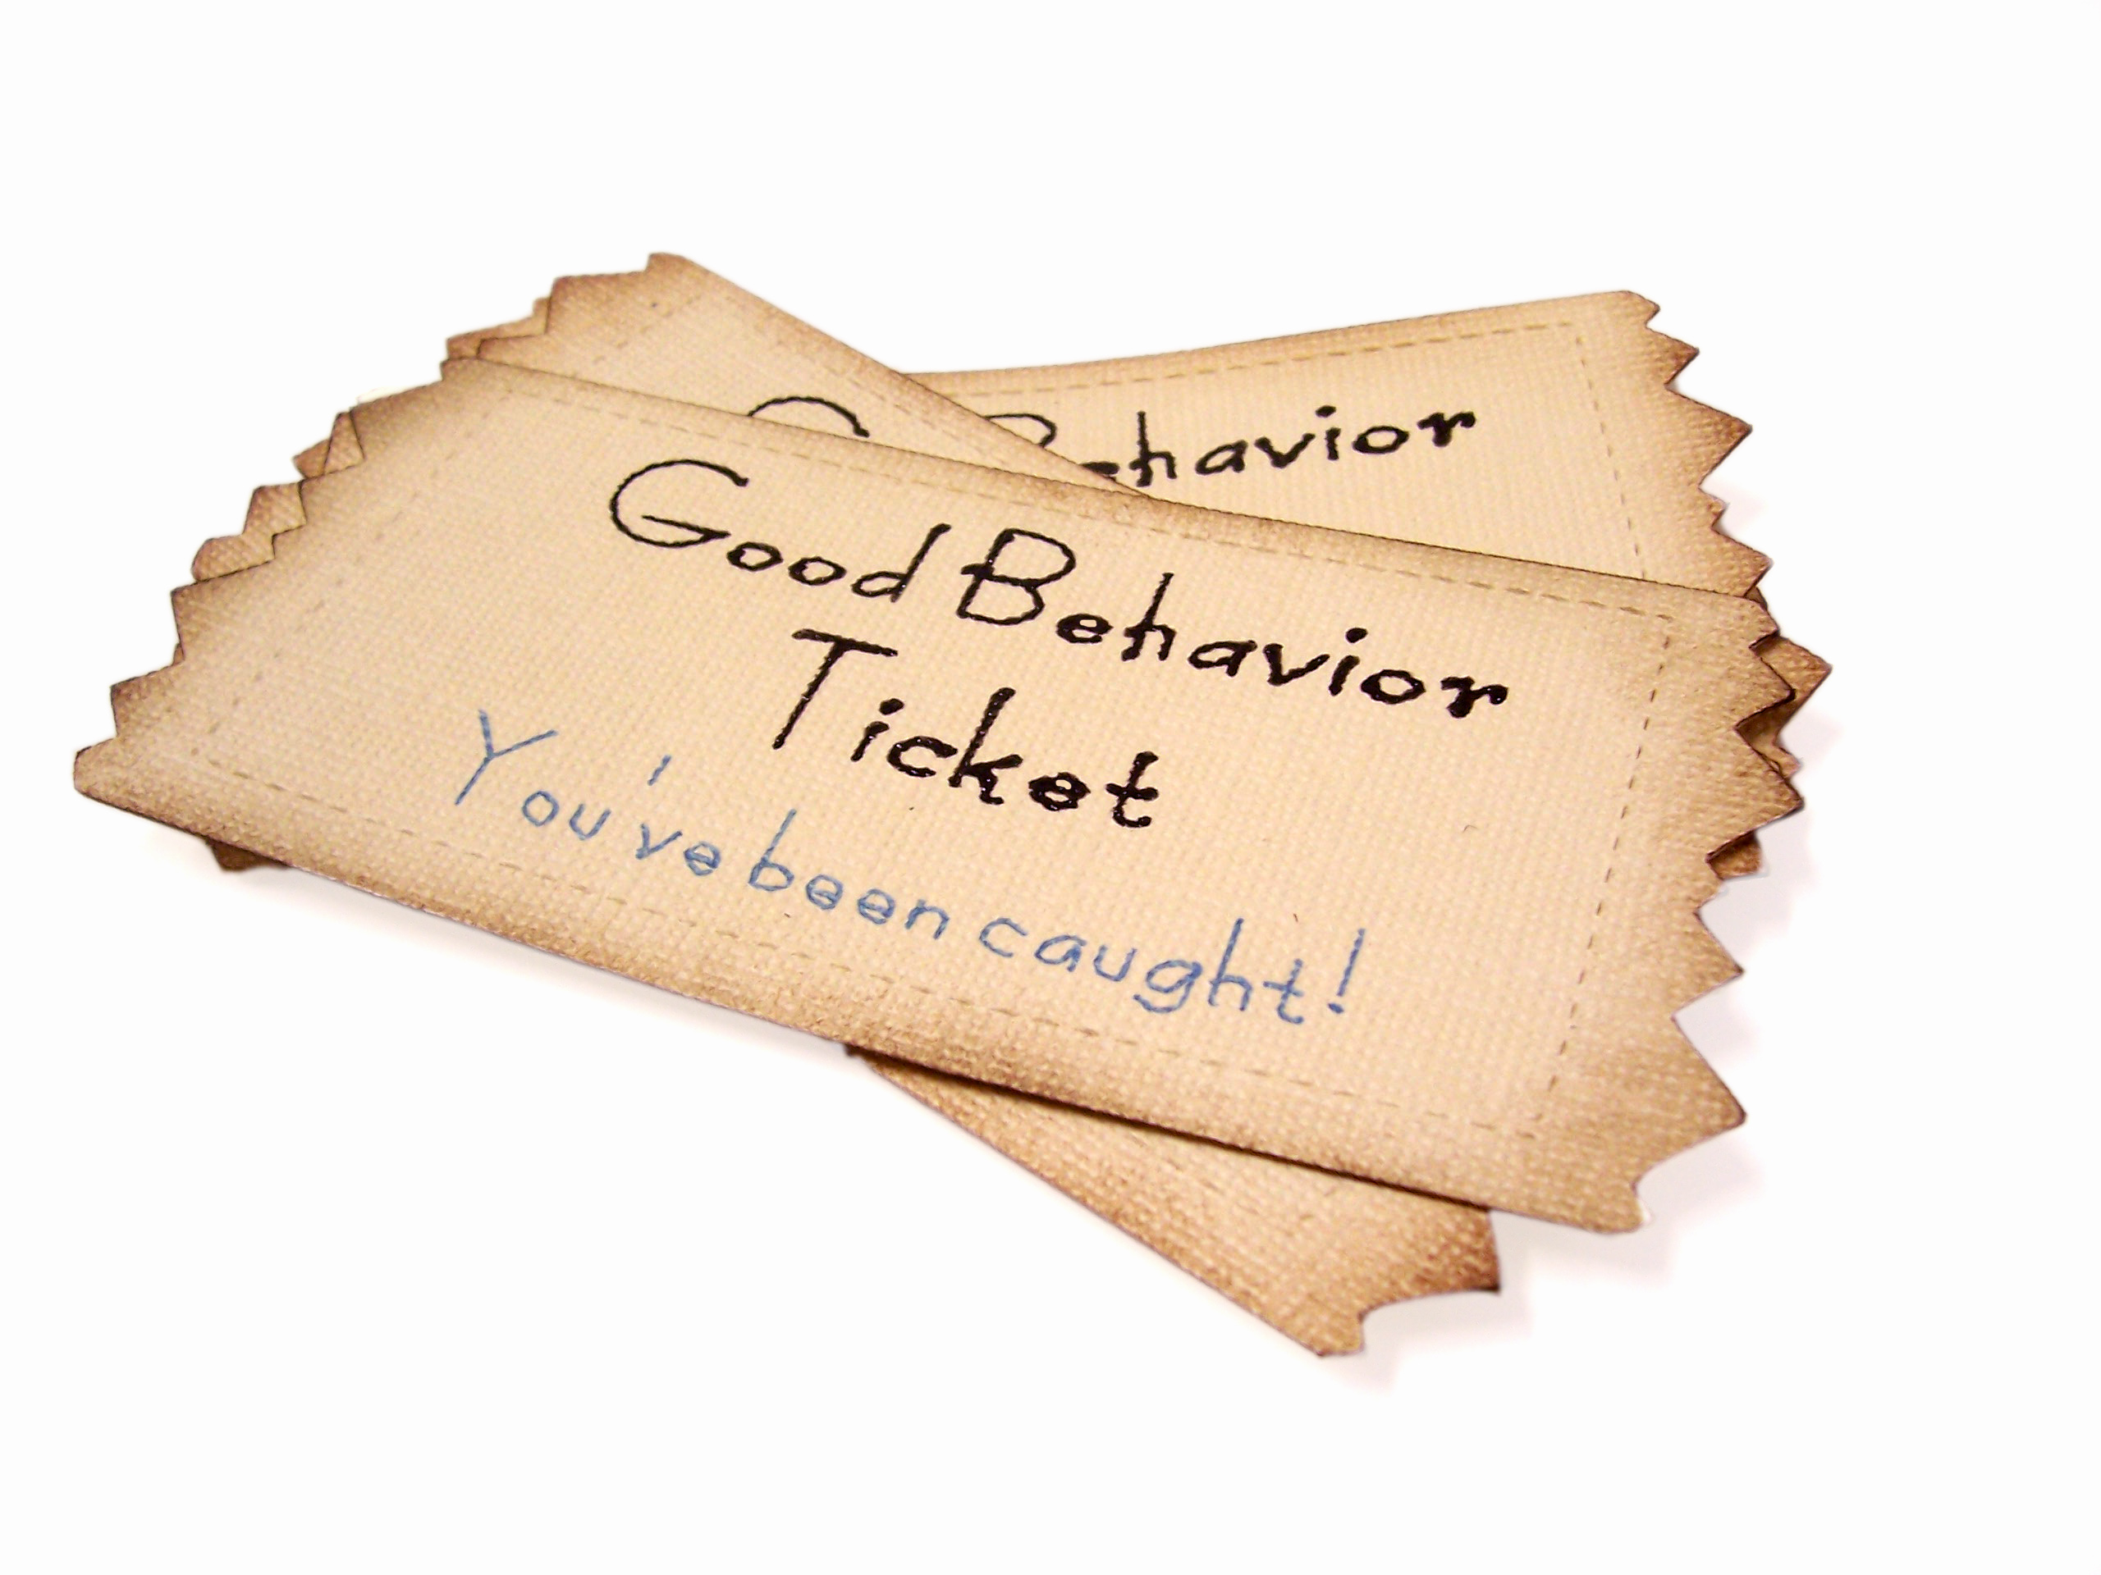
How to Use Rewards
Try rewarding good habits instead of good outcomes.
Ex: Reward your child if they study each night instead of rewarding them for an A on a test.
Don’t take away rewards that have already been earned.
If your child earns a reward, but then gets in trouble for something unrelated, don’t take the reward.
You can still set a consequence, but it should be separate.
Notes:
Good habit – reading with you at night.
Don’t take away rewards that were already given. “Here is your old phone”

Slide 11
Best Reward
The best reward you can give your child is your time.
One to one time where you can talk about life.
Nail salon or paint each others nails.
Favorite restaurant or food for only the two of you.
Notes:
Commit a day and time to have one to one time. Make it special and praise your child during this time. Listen to them without judgement.

Slide 12
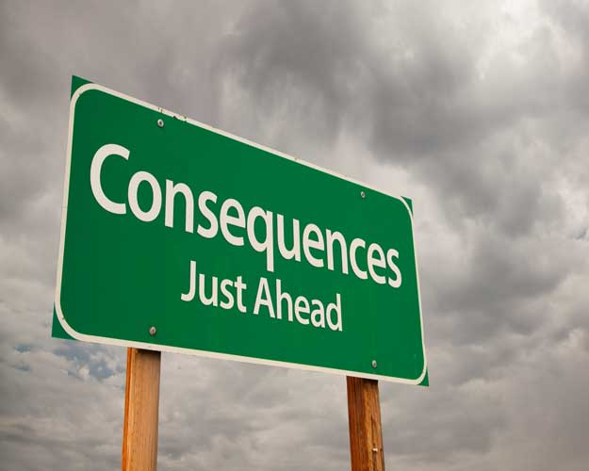
Consequences

Slide 13
Consequences
Like rewards, there are different ways to use consequences.
If used incorrectly, bad behaviors may become even worse.
If consequences have not been used consistently in the past, behaviors may worsen as the child may test limits and challenge parents.
Notes:
Be consistent and fair with every child. The duration of the discipline may be different for each child but make sure it is fair for all. “You always let her get away with that”.

Slide 14
How to Use Consequences
Create a few simple, clear rules and consequences.
Children will have hard time understanding complicated rules.
Always follow through.
Consequences will become meaningless if they never actually happen.
Don’t overdo it.
Avoid extreme/exaggerated consequences.
Ex: “You’re grounded for a month!”
Notes:
Simple, clear and concise. Don’t continue to repeat yourself.
Always follow through.
Avoid extremes. Use short term consequences. Grounded for the weekend. No phone for the next two days. Start small then work your way up. No phone for two days, four days, one week.

Slide 15
How to Use Consequences
Don’t overdo it. Seriously.
If you ground a child for a month, or take away everything they care about, they will have little motivation to be good.
Take away privileges.
Remove TV, phone, tablet, video game console, etc.
Notes:
Everything is a privilege even if you didn’t buy it for them or pay the bill for it.

Slide 16
How to Use Consequences
Avoid taking away something that’s good or can be used to cope in a positive manner.
Ex: if a child plays a sport and can get his/her frustrations out then it is beneficial for them.
Notes:
Don’t take away a sport if it helps them get their frustration out. You can limit the time before or after such as picking up the child immediately after practice so they don’t hang out with friends.

Slide 17
How to Use Consequences
Don’t punish out of anger.
If you’re upset, tell your child you need some time to think about their consequence.
The goal of the consequence isn’t to make you feel better- it’s to help the child learn a lesson.
You should be calm and rational; if you’re screaming, walk away.
Notes:
If you are angry at a situation ensure you take time to stop and think before giving out a years worth of consequences.

Slide 18
How to Use Consequences
Do NOT use Corporal punishment
Children who receive corporal punishment may learn that hitting and violence are appropriate responses to their problems or frustrations.
The behavior will be modeled.
Do Not use humiliation.
Shaming and humiliation may damage your relationship and cause distress that results in long-term consequences.
Notes:
Our actions speak louder than our words. If we handle situations with anger and violence then our children will handle it the same.
Humiliation only breaks the relationships. Using statements as big boys don’t cry conveys a message that they can’t show emotion.
Remember: Men and women do cry and its is ok.

Slide 19
Consequences
Talk to your child about why they are being disciplined.
Help them come up with strategies to not make the same mistake again.
Help them reflect on their actions.
Consequences won’t do much good if your child doesn’t learn from the experience.
Notes:
After the situation calms down. Let your child know that you will be talking about his later on when you the parent has calmed down.

Slide 20
Consequences
Let your child know that you will always love them but that you were not happy with their behaviors and actions.
Behaviors can change.

Slide 21
Useful Suggestions

Slide 22
Useful Suggestions
Don’t underestimate the power of a smile or a “good job.”
Choose your battles.
Try to catch your child being good.
The best way to help end a bad behavior is by rewarding the good behavior.
Praise behaviors instead of traits.
Ex: Praise a child’s hard work and effort/dedication rather than their intelligence.

Slide 23
Parenting
We assist all ages!
Program services are FREE!
Educational Workshops
Individual Case Management
Skills Groups
Services available to anyone residing in Orange County.

Slide 24
Questions?

